Slide 1
Applying CNN to Matching Talents for Jobs
Group Members: Li Tianpei, Yip Wai Ming, Zeng Menglan, Zhou Yiming, Zhao Wantong

Slide 2
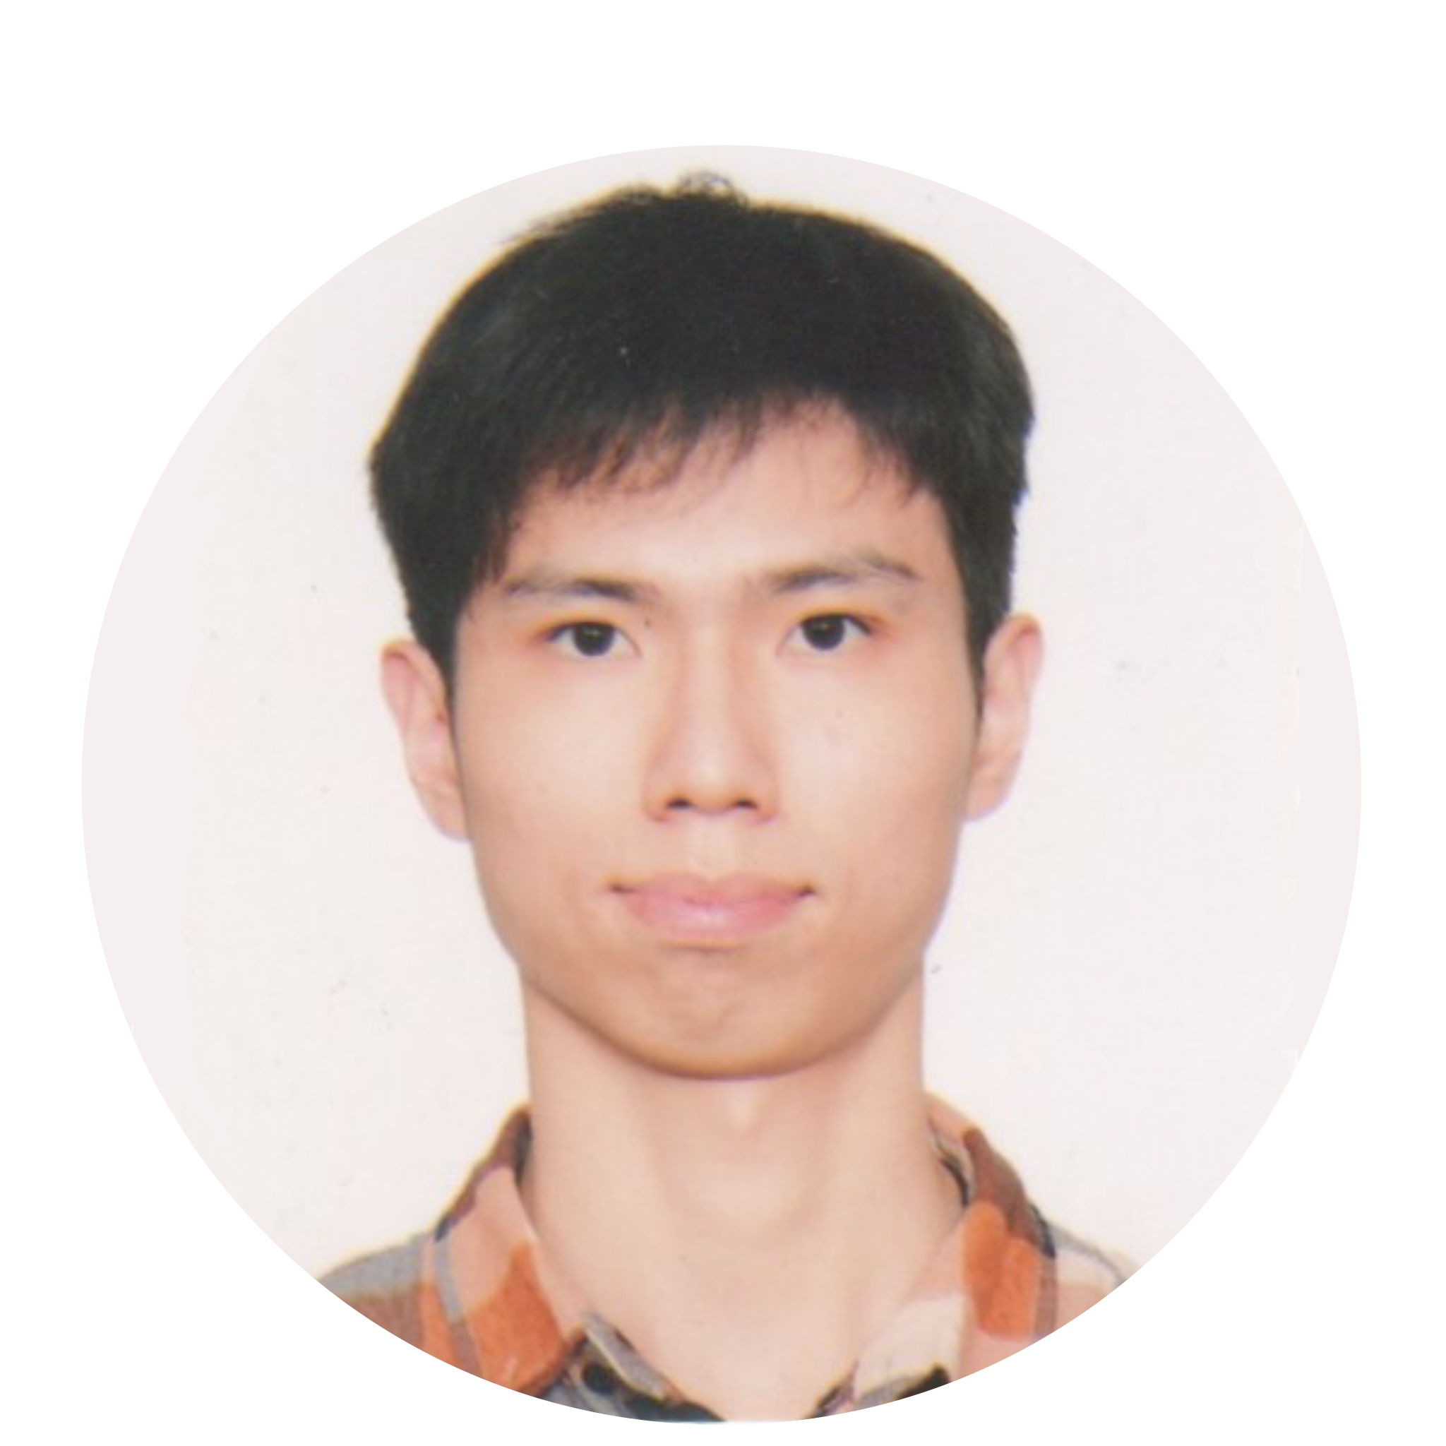
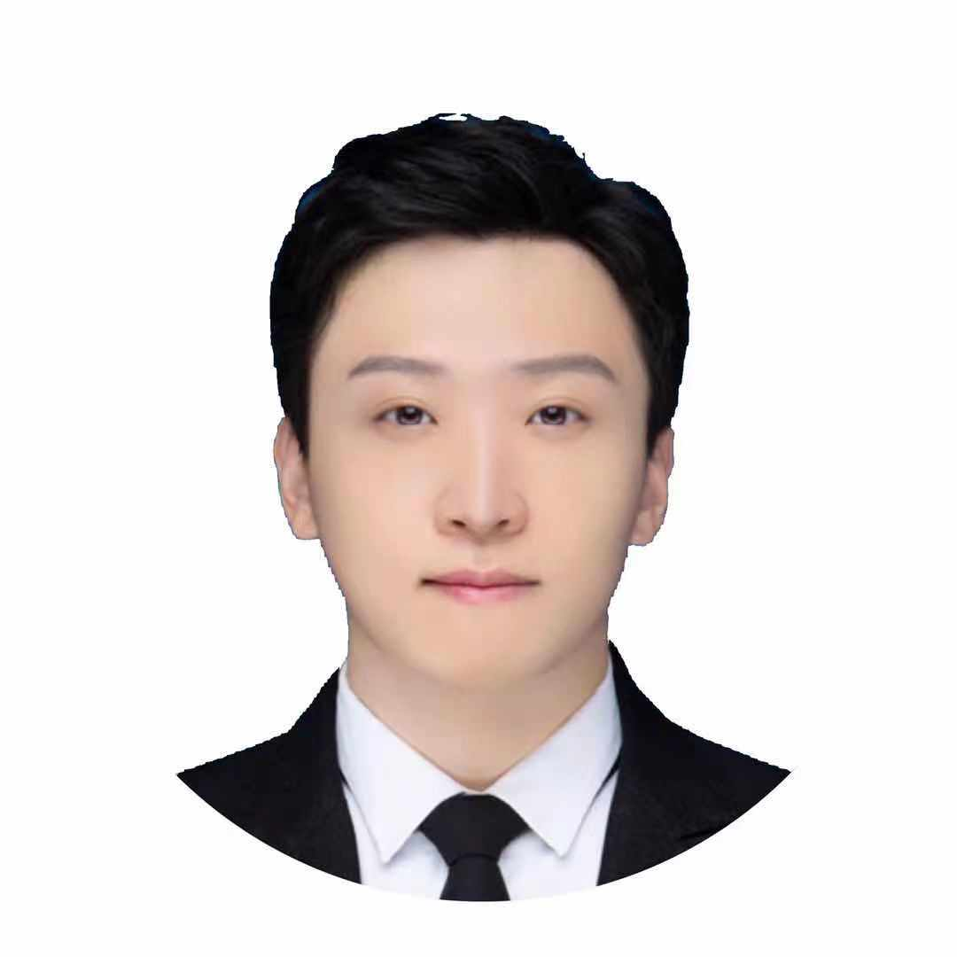
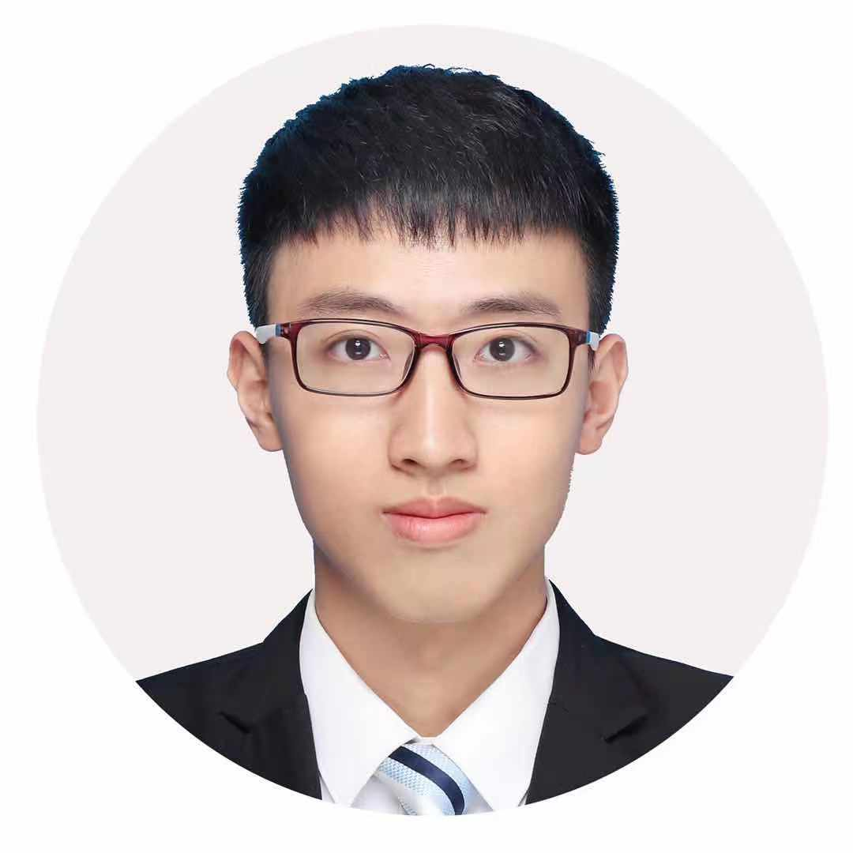

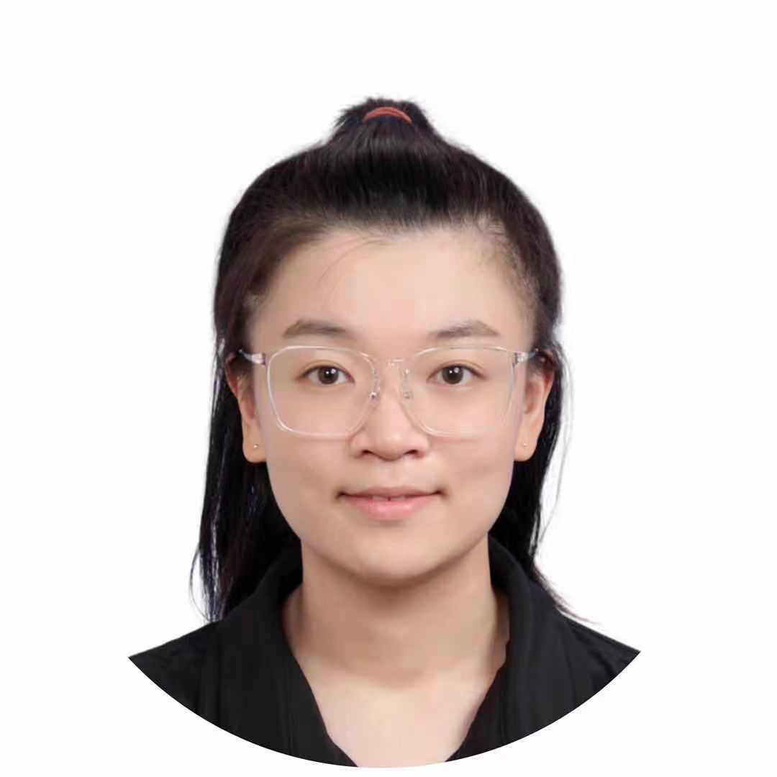
Table of Content
Introduction and Model Description
Data Preparation
Data Enhancement
Model Construction and Experiment
Conclusion

Slide 3
Introduction and Model Description
Yip wai ming

Slide 4
Introduction
Background
Traditionally, the suitability of a person to a job is preliminarily measured by his /her resume or a well-designed inventory questionnaire
Person-Job Fit= “compatibility between individuals and the job”
Yip wai ming
Notes:
Firstly, I would like to briefly introduce the background of the model.
Traditionally, a recruiter/HR prelimarily measures the suitability of a person to a job is by resume and a well-designed inventory questionnaire without objective measuremen
And the terms Person-Job Fit= “compatibility between individuals and the job”
Our issue is how to use machine learning to help the person job fit matching.

Slide 5
Model Description
What does the model propose to do?
Assumptions of the model
Both job posts and cv can be projected onto a shared latent representation.
Each requirement item on the job posting and each work experience item in the cv can be represented by a vector on the shared latent representation.
Each right job post and its corresponding right candidate’s cv should be similar in the representation space.
Yip wai ming
Notes:
What does our model proposed to do? What the model trying to do here is to convert each job posting/resume(which is the input of the model) to a latent vector (output of the model) so that the right job and the right candidate would share the highest similarity in the latent representation space.
.
Latent means hidden because the model captures details and understands the input in the intermediate layer (which is hidden) of the CNN model so we call it latent space.
There are some assumptions for the model:
Both job posts and cv can be projected onto a shared latent representation.
Each requirement item on the job posting and each work experience item in the cv can be represented by a vector on the latent representation.
Each job post and its corresponding cv should be similar in the representation space.
So , these are the aussumptions of the model.

Slide 6
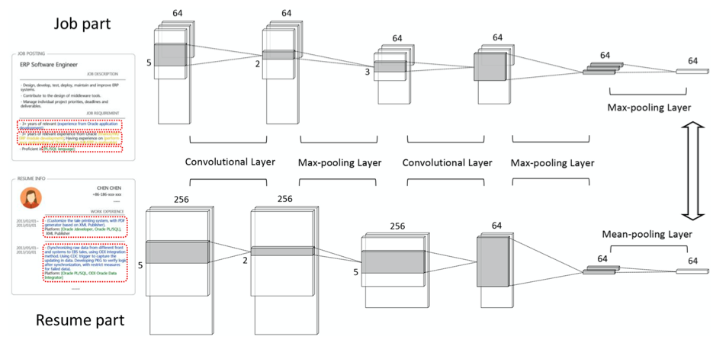
Model Description
Person-Job Fit Neural Network
Convolutional Neural Network
The architecture of PFJNN can be separated into two parts.
Two 1-dimensional convolutional layers are applied on each requirement item.
Convolutional layers is followed by a max-pooling layer.
Yip wai ming
Notes:
Here you can see the structure of the model. The details of the model would be discussed by my colleague in the later part of the presentation. Now I will first introduce some basics of the model.

Slide 7
Model Description
Preliminary
The recruitment data consist of three parts: Job posting(job requirements), Resume(work experience), and Job application records.
Successful Job
Application Records (A)
Failed Job
Application Records (f)
record =
( Job requirement items, work experience items )
record =
( Job requirement items, work experience items )
.
.
.
.
.
.
Yip wai ming
Notes:
The data to be fed into the model will be as follow:
There will be a collection of successful job application records and failed job application records.
For each job application record, there would be a pair of ji and ri.
Successful and fail are both included To enhance the model’s ability to measure similarity and dissimilarity between a job and a resume.

Slide 8
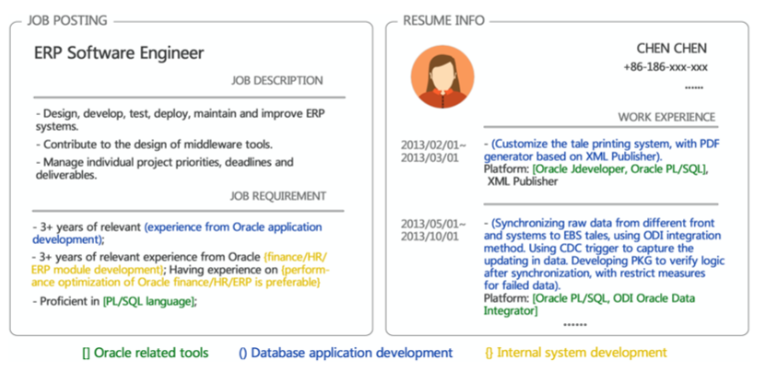
Model Description – an example
Yip wai ming
Notes:
To give you an example, usually for a job application, there would be a job posting, like the one you would usually see in Linkedin or JobsDB something like that consisting mainly of job requirements; and each candidate would have a resume, consisting of their work exp.
Assume this is a pair of successful job application record.
One of the challenge of the model is how do we quantify the document data of CV and job posting, which are texts, so as to fit these text data to the model.
The model proposed to use vector to represent these texts.
First, the job posting is composed of each job requirement, for example, 3 years of …; while the resume is composed of each work experience.
THen, each job requirement can be comprehended as a sentence consisting of S words, S is the number of words in that job requirement.
Third, each word in the job requirement can be represented by a vector using word embeddings.
These can be visualised in the next slide.

Slide 9
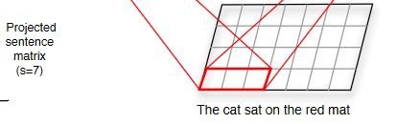
Model Description
Input and output of the model
Input :
For each job requirement consisting of S words , S= [w_{1,} w₂,…, w_{s}]
For each job posting or CV, J_{i}= [S₁, S₂,…, S_{nji}]
Output:
A vector of 64 dimension for each job posting or CV.
Yip wai ming
Notes:
For each job requirement, it can be represented by a collection of word, each one as a vector. So it actually becomes a matrix like the one on the right upper corner.
For each job posting, it can be represented as a collection of S.
The output of the model after as sequence of convolutional layer and max pooling layer would be vector of 64 dimensions for each job posting or CV. The details would be discussed by my colleague in the fourth part of the presentation where we implement the model.

Slide 10
Data Preparation
ZHou yiming

Slide 11
Data Preparation
Different paths and data types
Chinese characters and punctuations
Encoded by different codings
ZHou yiming

Slide 12
Data Preparation
Scan the paths of resumes
Transform .pdf to .txt by Pdfminer
Transform .doc to .txt by Win32com
ZHou yiming

Slide 13
Data Preparation
Delete Chinese characters and punctuations by Zhon
Decode with GB18030
Endode to utf-8
ZHou yiming

Slide 14
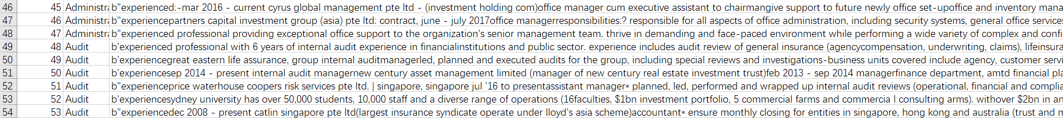
Data Preparation
ID /category/working experiences
Scan the paths
Eg. C:\Desktop\Resume\Administration\CDIB HK - Office Manager\Addleshaw_Treliza Li_Office Manager.txt
ZHou yiming

Slide 15
Data Enhancement
Li Tianpei

Slide 16
Why Data Enhancement
We learn from mistake: acc in test dataset only 10%
Not Enough Data
Good Acc in Train Dataset
Bad Acc in Test Dataset
Overfitting
Paper: Million
Our Dataset: Thousand
Complex Enough
Can't explain
Model is Wrong
Li Tianpei

Slide 17
Enhancement Method
Three Different methods:
Synonym Exchange
Delete Words Randomly
Exchange Two Word Positions Randomly
1229
Numbers
40000+
Li Tianpei

Slide 18
Enhancement Process
Consideration: Running Time, Amount of Data, Randomness
74.5%
Data Enhancement
Synonym substitution
Data Enhancement
Step 1
Exchange Words Randomly
Step 2
Exchange Words Randomly
Step 3
Step 4
Dataset 1.0
Final Dataset
Random Selected Data
Dataset 2.0
Delete Words Randomly
Synonym substitution
Merge Document with Same Type
Li tianpei

Slide 19
Model Construction and Experiment
Zeng menglan

Slide 20
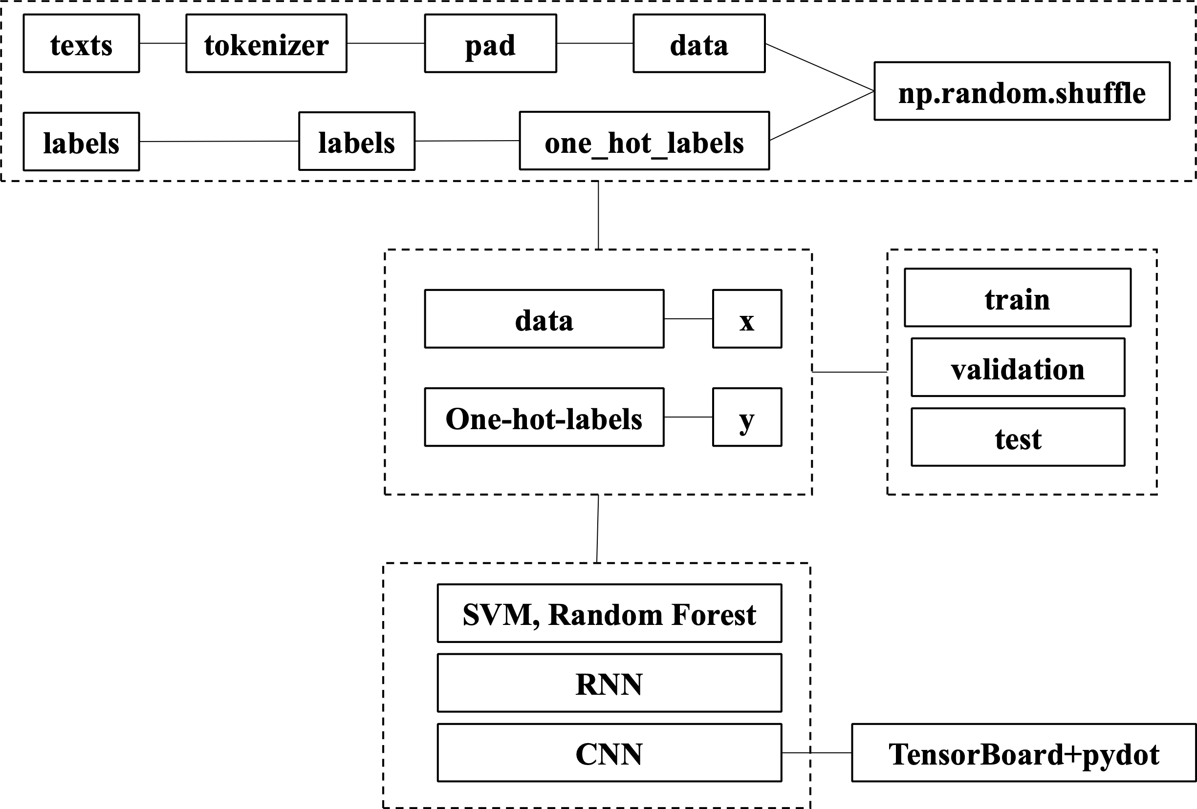
Model Construction
Zeng menglan

Slide 21
Traditional ML Method
Evaluation on Person-Job Fit Neural Network
Baselines Methods
Select several classic classification method as baselines, including Grid Search, Support Vector Machine, Decision Tree, Random Forests, and K-neighbors Classifier.
Treat the mean vector of all word vectors in resume or job posting as its latent vector.
Input: latent vector of resume and corresponding job posting.
Zeng menglan

Slide 22
RNN vs CNN
In text mining, most DNNs can be classified into two categories, CNN and RNN.
CNN can better capture the hierarchical relationships and local semantics between a job posting (resume) and its requirement (work experience) items.
is the effect of CNN really better than RNN?
?
Zeng menglan

Slide 23
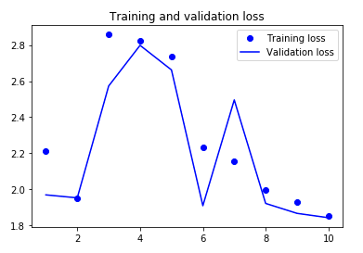
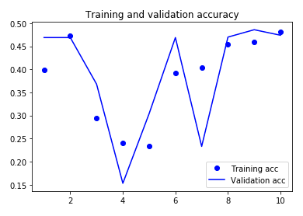
Experiment of RNN
Training and Validation Accuracy of RNN
Training and Validation loss of RNN
Zeng menglan

Slide 24
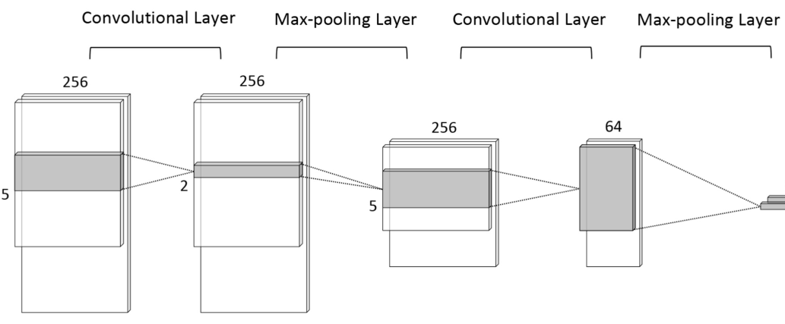
Model Construction of CNN
Convolutional Neutral Network
Encode words of resume into 256-dimension vectors
Dropout = 0.5
Zeng menglan

Slide 25
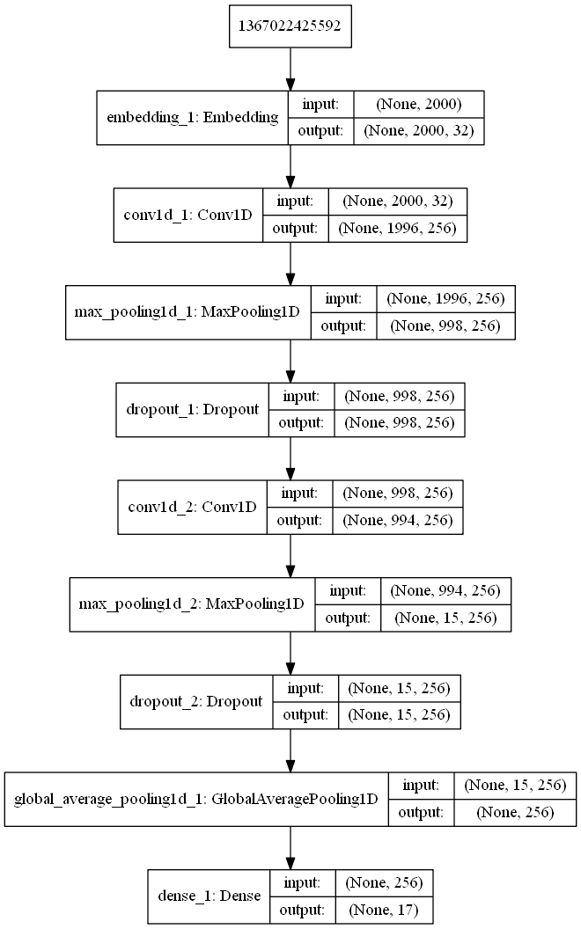
Model Structure visualization
Pydot——visualize the structure of the model
TensorBoard——Monitoring the variation of the model structure and updating with each epoch.
Zeng menglan

Slide 26
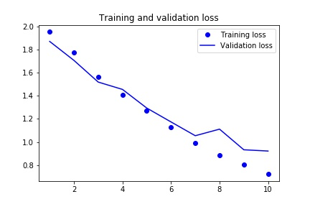
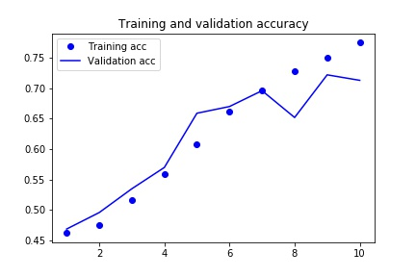
Experiment of CNN
Training and Validation Accuracy of CNN
Training and Validation loss of CNN
Zeng menglan

Slide 27
Conclusion
Zhao wantong

Slide 28
Conclusion
Major contribution:
1. Formulate Person-Job Fit.
2. A novel CNN-based end-to-end model named PJENN.
3. The proposed method has been practiced in real-world scenarios.
zhao wantong

Slide 29
More field
Careers Guidance in University
Company 1
Job Requirements
Resume
Company 2
University
Students
Suitable students
Feedback
Company 3
Zhao wantong

Slide 30
Reference
Chen Zhu, Hengshu Zhu, Hui Xiong, Chao Ma, Fang Xie, Pengliang Ding, and Pan Li. 2018. Person-Job Fit: Adapting the Right Talent for the Right Job with Joint Representation Learning. ACM Trans. Manage. Inf. Syst. 9, 3, Article 12 (September 2018), 17 pages. https://doi.org/10.1145/3234465
Dataset: https://s3.ap-south-1.amazonaws.com/codebyte-bucket/Resume%26Job_Descriptions.zip

